Slide 1
GAMING TECHNOLOGY
Prepared by: Domingo, John Carlo R.
ICS1 – MWF 1:45PM-3:00PM

Slide 2
OBJECTIVES
  Introduction
  History
  Consoles
  PC
  Consoles VS PC
  Advantage/Disadvantage
  Conclusion

Slide 3
Introduction
People play games on console and pc for entertainment or to spend their leisure time.
PC is the major source of gaming, as compared to console, console is just a gaming platform while pc is much more powerful, and can operate multifunction.
Mostly gamers enjoy gaming on pc because in consoles games have glitches.

Slide 4
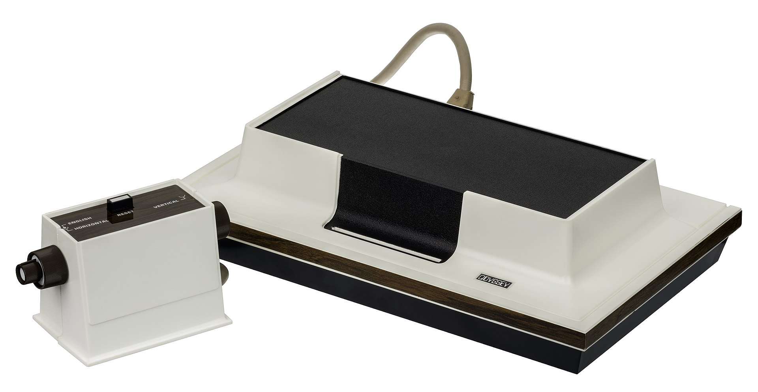
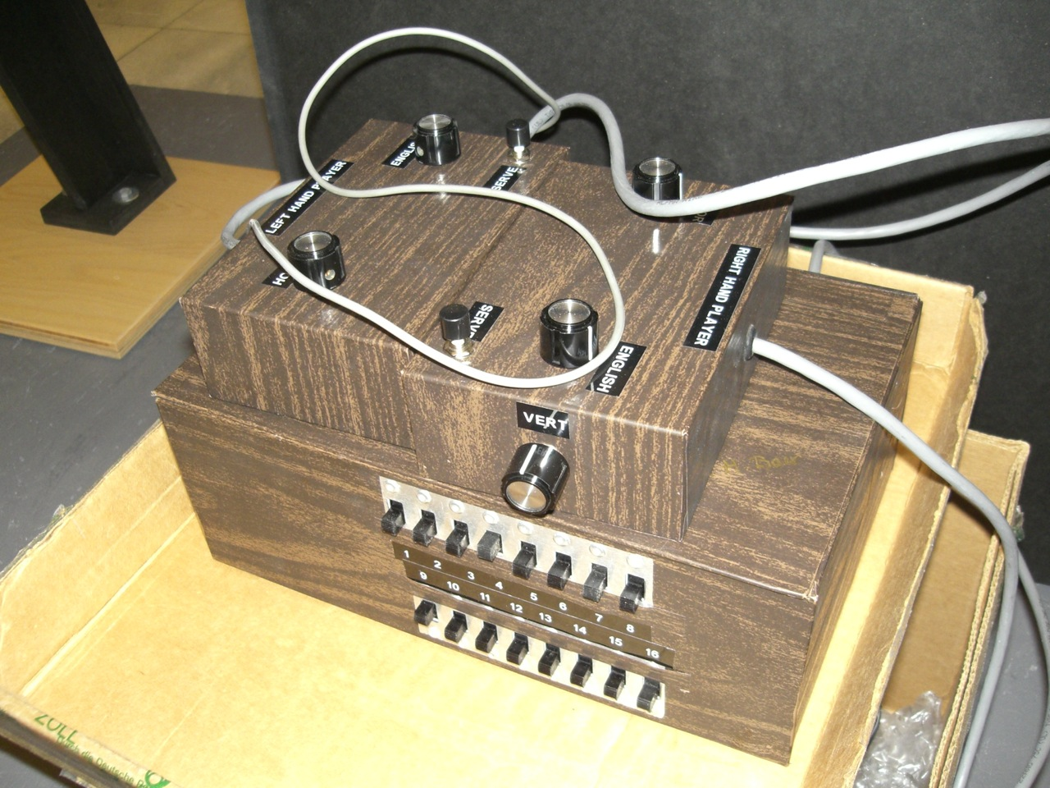
History
The Magnavox Odyssey id the world's first commercial home video game console. It was first demonsrated in April 1972.

Slide 5
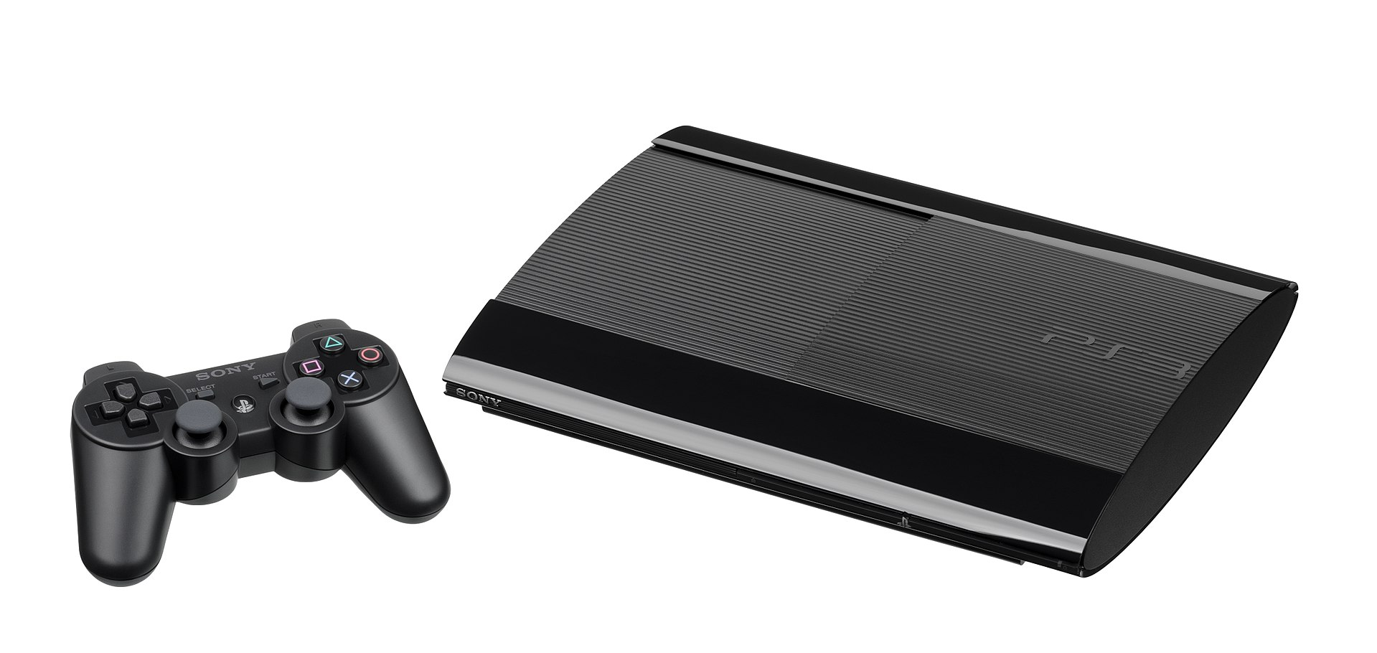
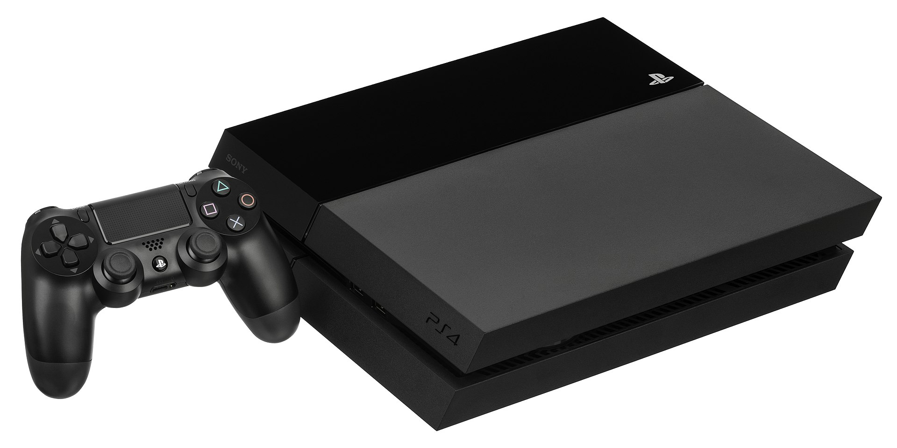
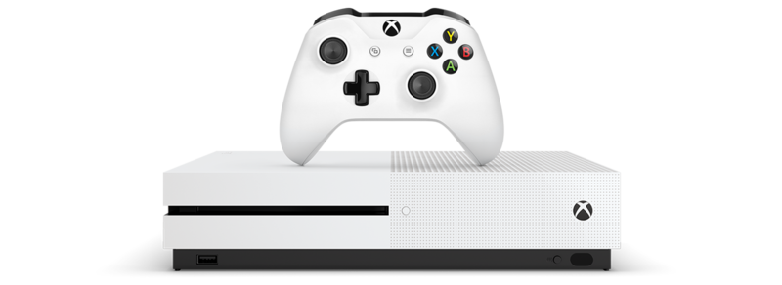
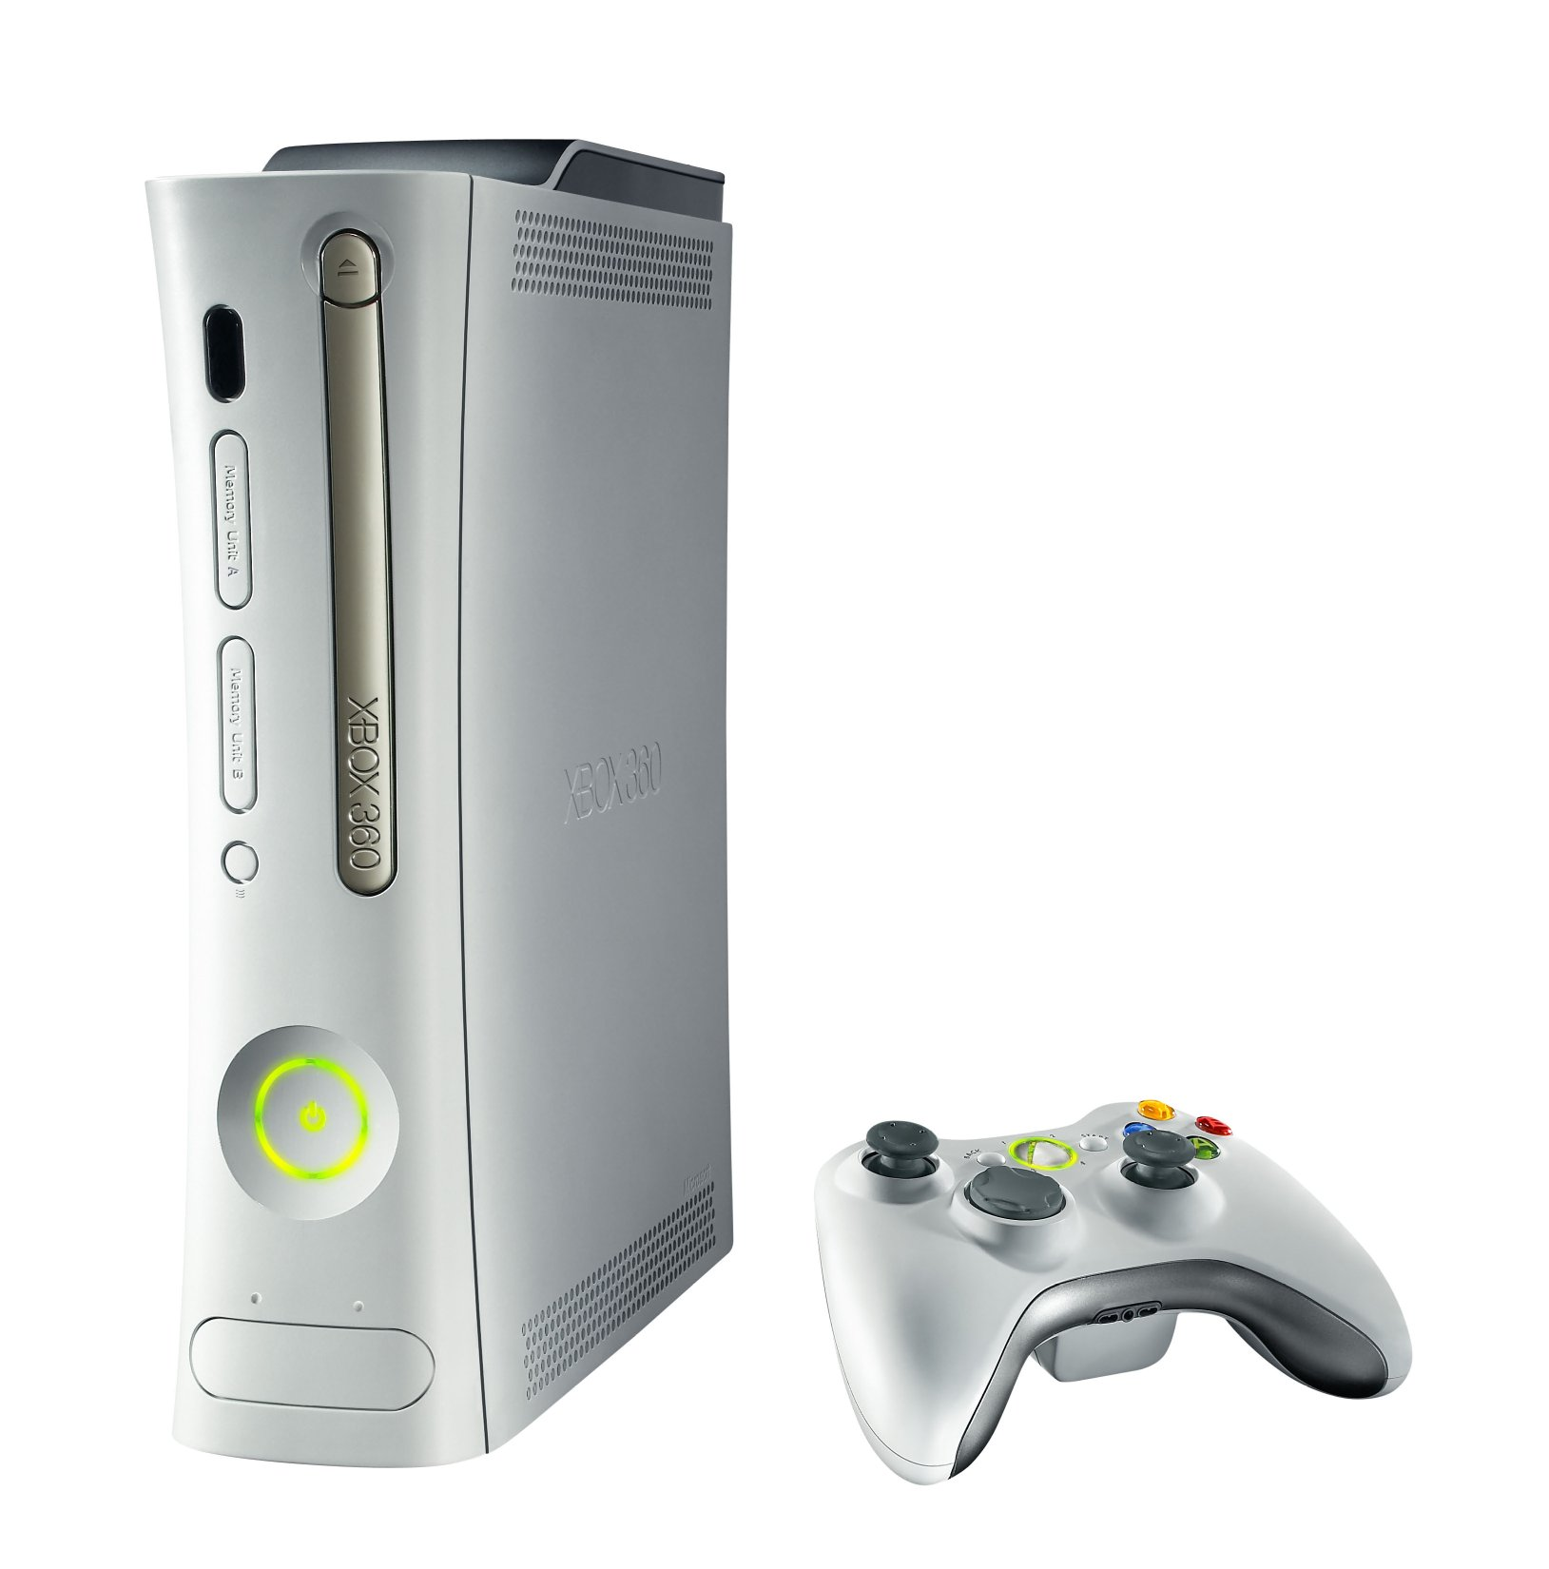
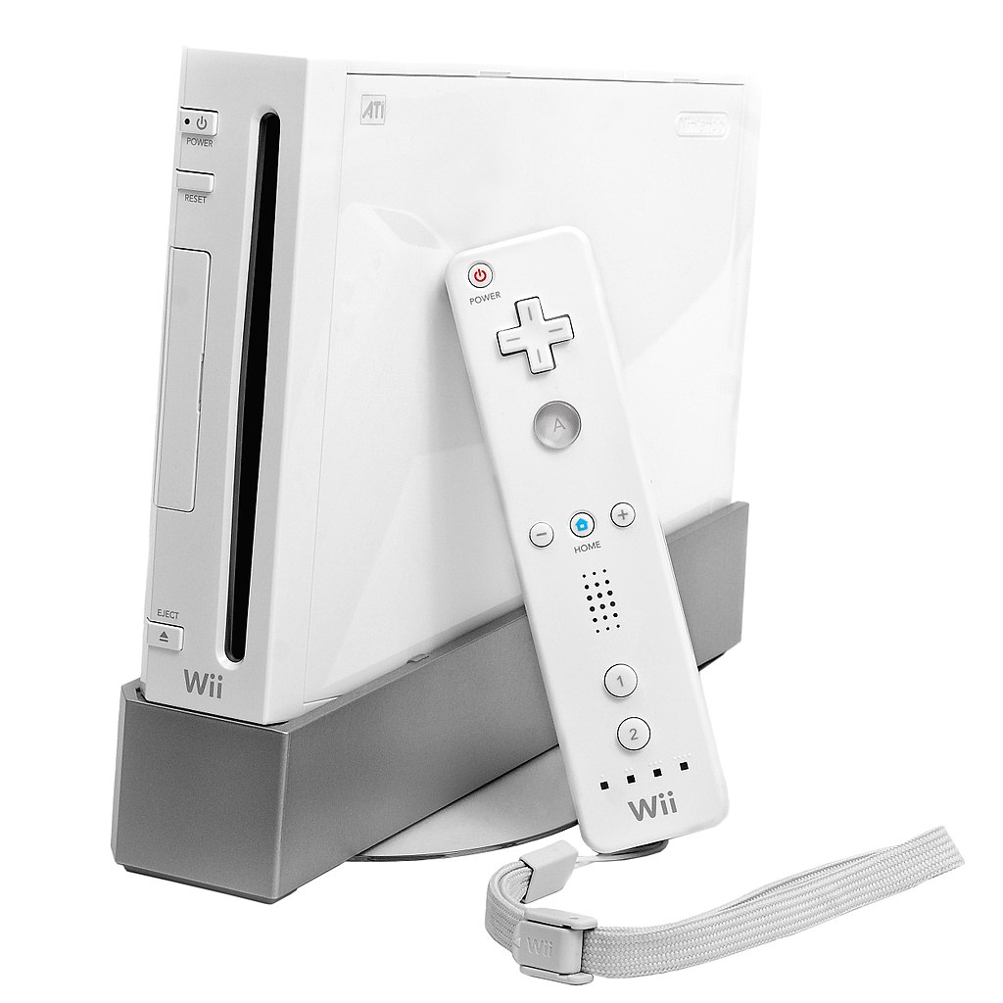
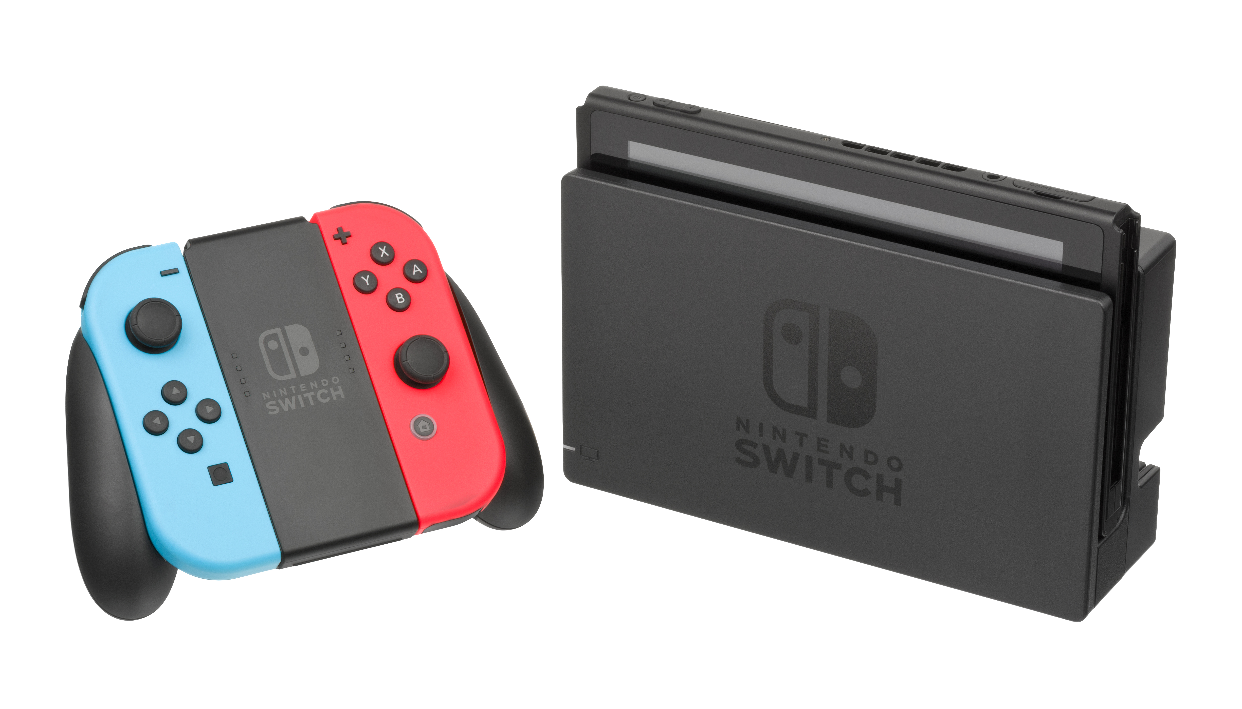
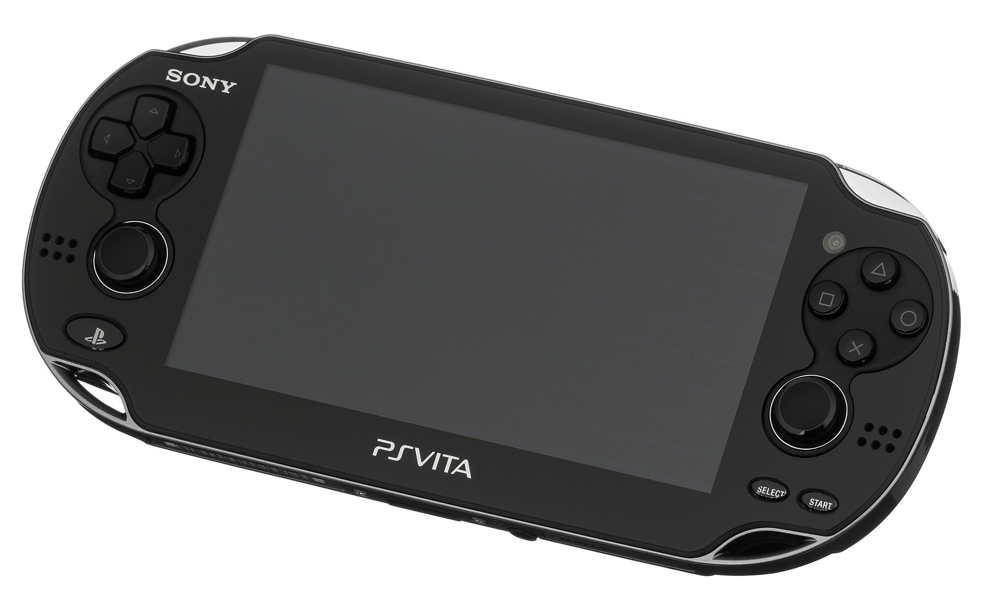
Consoles
The are number of consoles in the world, but the most famous consoles are:
Playstation 1,2,3,4 (Sony)
Xbox 360, One (Microsoft)
Wii, Wii U (Nintendo)
Nintendo 3DS, Switch
PS VITA
PS Vita

Slide 6
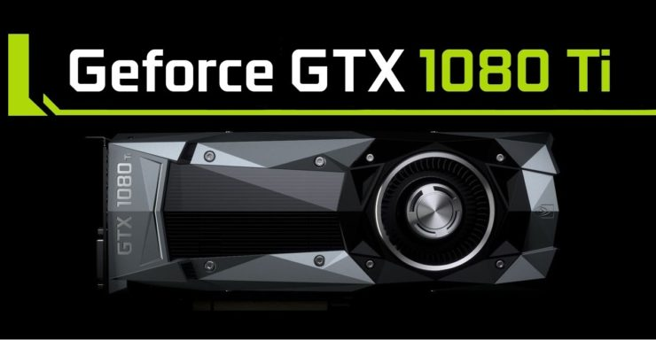
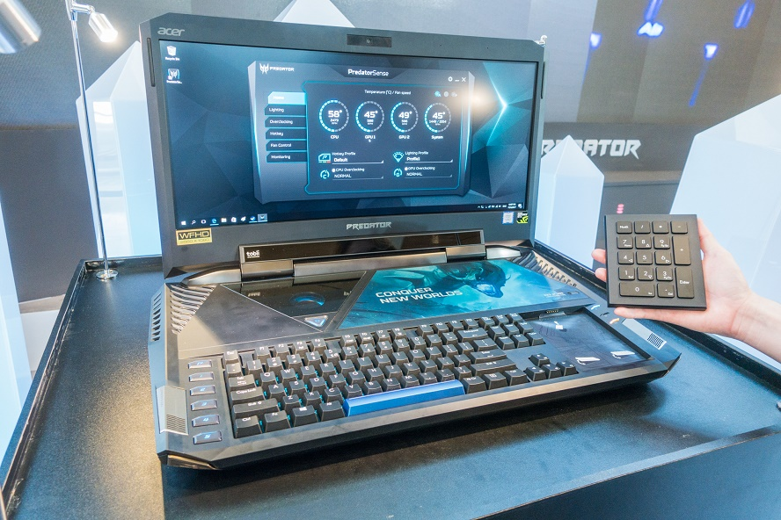
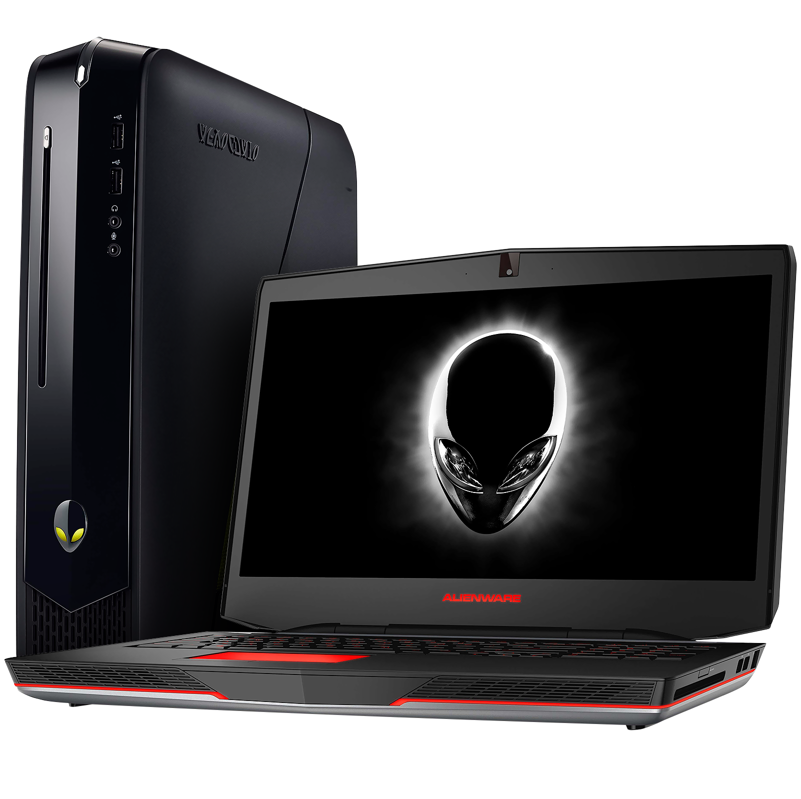
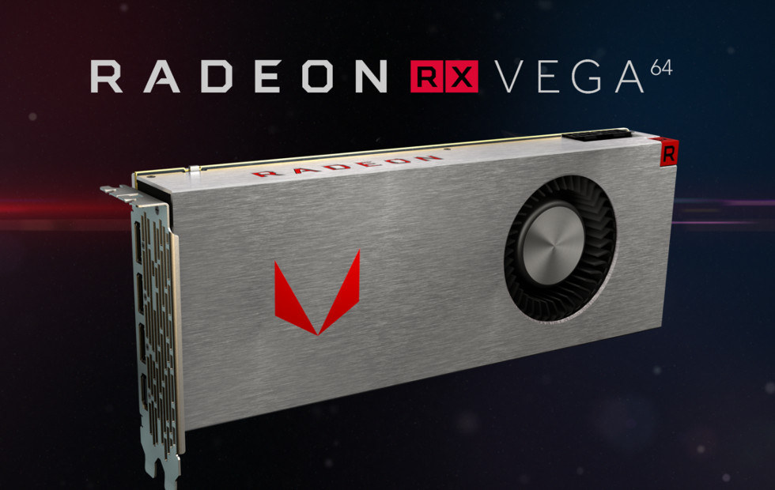
PC
PC is the major source of gaming, because it has the most powerful graphic cards and processors. Some of the most powerful video cards are NVIDIA GTX 1080 ti, AMD RADEON RX VEGA 64
Alienware, Predator & Falcon are the most expensive and powerful PC in the world.

Slide 7
Console VS PC
Console PC
- Cheaper - Expensive
- Low Graphics -High Graphics
-30+ FPS -60+ FPS
- Not Upgradeable -Upgradeable
-Limited Performance - Maximum Performance

Slide 8
Motion Technology
Motion technology is being used in consoles (Xbox, Wii, PS3,4) but in February 2012 Microsoft introduced Kinect technology in PC and Xbox.
Sony also have motion technology for PS3/PS4 (Playstation move)

Slide 9
Advantages and Disadvantages
Advantage Disadvantage
- Entertainmnet -Failing Vision
- Something to do - Less Exercise
  when bored - Addictive
  Some Games - Major Time Waster
  are educational - Can cause anxiety

Slide 10
Conclusion
It really depends upon the person which he/she prefers. There are some games that is exclusively made for the console that is not available for PC and vice versa.
Some PC games are moddable and can achieve real time movements.
Consoles is basically cheaper than PC's

